Slide 1
SUBJECT NAME: Microprocessor
SUBJECT CODE: 303105210

Slide 2
What is Microprocessor?
A microprocessor is a programmable electronics chip that has computing and decision making capabilities similar to central processing unit of a computer.
It is clock driven IC
It is Si type of semiconductor chip which contain no. of transistors.
It is register array based device.
Microprocessor is used as multipurpose
I/P
Microprocessor
O/P
Technology Used: The semiconductor manufacturing technologies used for chips are:
• Transistor-Transistor Logic (TTL)
• Emitter Coupled Logic (ECL)
• Complementary Metal-Oxide Semiconductor (CMOS)

Slide 3
Classification of Microprocessors:
Based on size of data bus:
4-bit microprocessor
8-bit microprocessor
16-bit microprocessor
32-bit microprocessor
Based on architecture:
Reduced Instruction Set Computer (RISC) processors
Complex Instruction Set Computer (CISC) processors
Based on application:
General-purpose microprocessor- used in general computer system and can be used by programmer for any application. Examples, 8085 to Intel Pentium.
Microcontroller- microprocessor with built-in memory and ports and can be programmed for any generic control application. Example, 8051.
Special-purpose processors- designed to handle special functions required for an application. Examples, digital signal processors and application-specific integrated circuit (ASIC) chips.

Slide 4
History of Microprocessors:

Slide 5
4-BIT MICROPROCESSORS
4

Slide 6
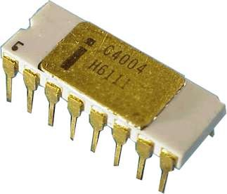
INTEL 4004
Introduced in 1971.
It was the first microprocessor by Intel.
It was a 4-bit µP.
Its clock speed was 740KHz.
It had 2,300 transistors.
It could execute around 60,000 instructions per second.
5

Slide 7
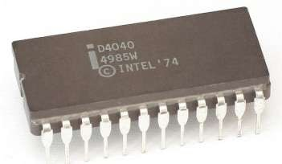
INTEL 4040
Introduced in 1974.
It was also 4-bit µP.
6

Slide 8
8-BIT MICROPROCESSORS
7

Slide 9
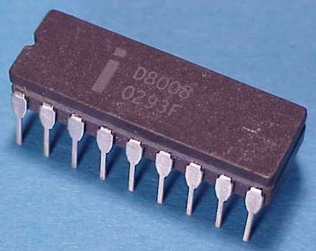
INTEL 8008
Introduced in 1972.
It was first 8-bit µP.
Its clock speed was 500 KHz.
Could execute 50,000 instructions per second.
8

Slide 10
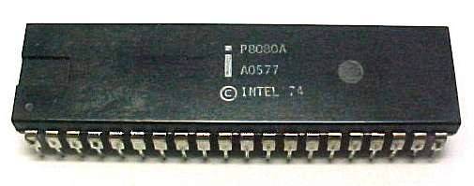
INTEL 8080
Introduced in 1974.
It was also 8-bit µP.
Its clock speed was 2 MHz.
It had 6,000 transistors.
Was 10 times faster than
8008.
Could execute 5,00,000 instructions per second.
9

Slide 11
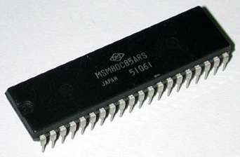
INTEL 8085
Introduced in 1976.
It was also 8-bit µP.
Its clock speed was 3 MHz.
Its data bus is 8-bit and address bus is 16-bit.
It had 6,500 transistors.
Could execute 7,69,230 instructions per second.
It could access 64 KB of
memory.
It had 246 instructions.
10

Slide 12
16-BIT MICROPROCESSORS
11

Slide 13
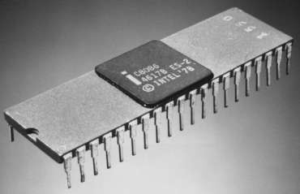
Introduced in 1978.
INTEL 8086
It was first 16-bit µP.
Its clock speed is 4.77 MHz, 8 MHz and 10 MHz, depending on the version.
Its data bus is 16-bit and address bus is 20-bit.
It had 29,000 transistors.
Could execute 2.5 million instructions per second.
It could access 1 MB of memory.
It had 22,000 instructions.
It had Multiply and Divide
instructions.
12

Slide 14
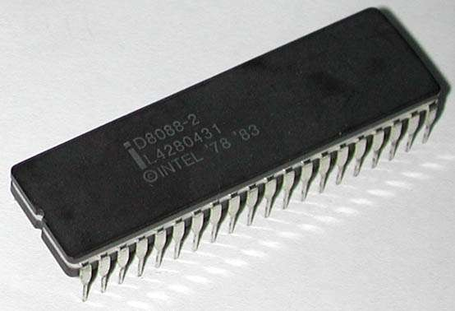
INTEL 8088
Introduced in 1979.
It was also 16-bit µP.
It was created as a cheaper
version of Intel’s 8086.
It was a 16-bit processor with an 8-bit external bus.
13

Slide 15
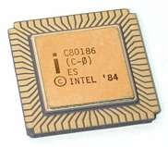
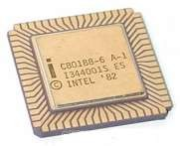
INTEL 80186 & 80188
Introduced in 1982.
They were 16-bit µPs.
Clock speed was 6 MHz.
14

Slide 16
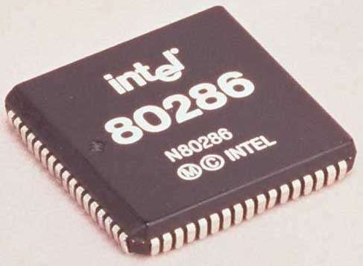
INTEL 80286
Introduced in 1982.
It was 16-bit µP.
Its clock speed was 8 MHz.
15

Slide 17
32-BIT MICROPROCESSORS
16

Slide 18
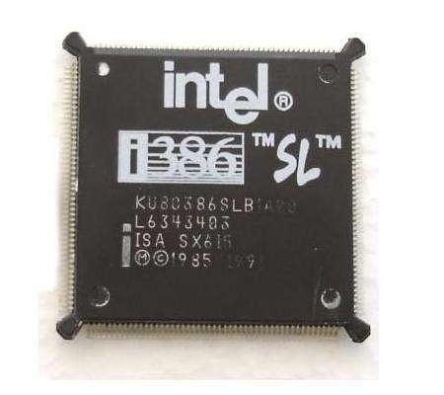
Introduced in 1986.
INTEL 80386
It was first 32-bit µP.
Its data bus is 32-bit and address bus is 32-bit.
It could address 4 GB of memory.
17

Slide 19
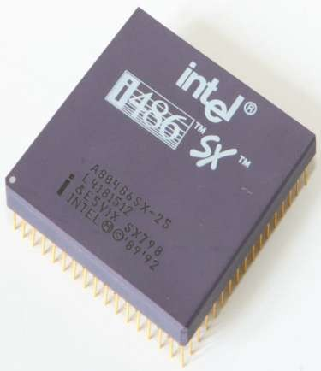
Introduced in 1989.
INTEL 80486
It was also 32-bit µP.
It had 1.2 million transistors.
Its clock speed varied from 16 MHz to 100 MHz depending upon the various versions.
18

Slide 20
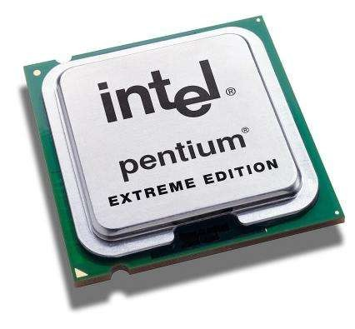
Introduced in 1993.
INTEL PENTIUM
It was also 32-bit µP.
It was originally named 80586.
Its clock speed was 66 MHz.
19

Slide 21
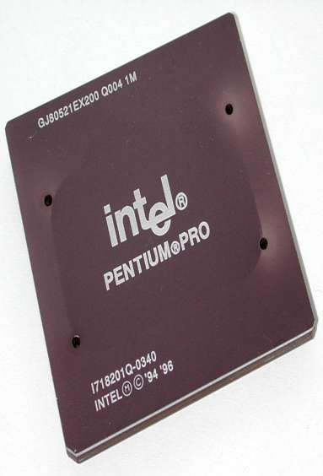
INTEL PENTIUM PRO
Introduced in 1995.
It was also 32-bit µP.

Slide 22
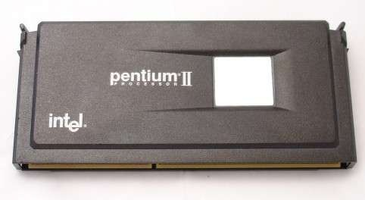
INTEL PENTIUM II
Introduced in 1997.
It was also 32-bit µP.
21

Slide 23
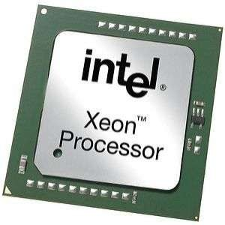
INTEL PENTIUM II XEON
Introduced in 1998.
It was also 32-bit µP.
22

Slide 24
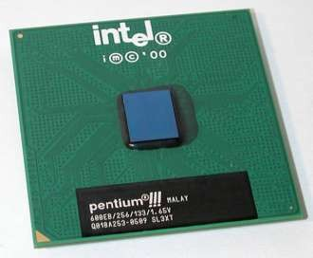
INTEL PENTIUM III
Introduced in 1999.
It was also 32-bit µP.
23

Slide 25
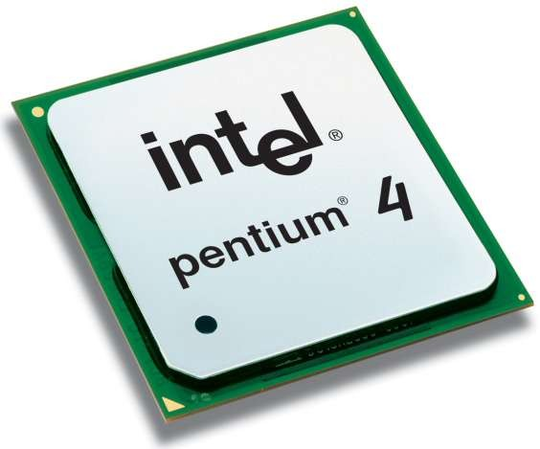
INTEL PENTIUM IV
Introduced in 2000.
It was also 32-bit µP.
24

Slide 26
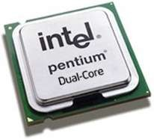
INTEL DUAL CORE
Introduced in 2006.
It is 32-bit or 64-bit µP.
It has two cores.
Both the cores have there own internal bus and L1 cache, but share the external bus and L2 cache
25

Slide 27
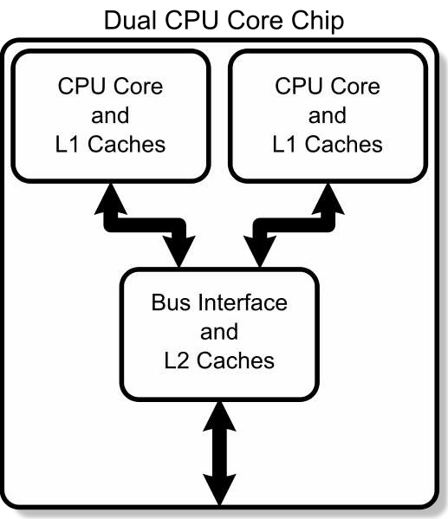
26

Slide 28
64-BIT MICROPROCESSORS
27

Slide 29
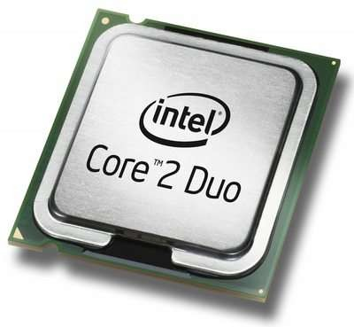
INTEL CORE 2
Introduced in 2006.
It is a 64-bit µP.
28

Slide 30
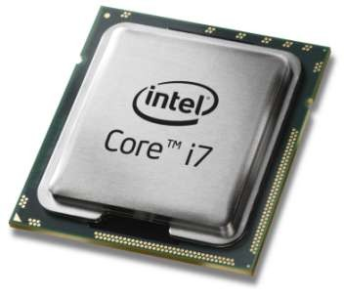
INTEL CORE I7
Introduced in 2008.
It is a 64-bit µP.
29

Slide 31
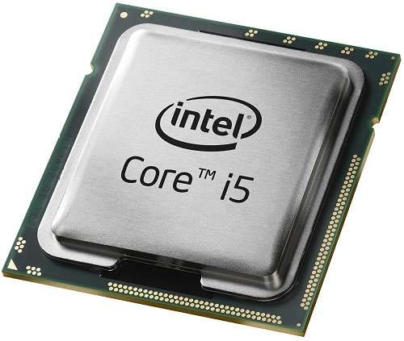
INTEL CORE I5
Introduced in 2009.
It is a 64-bit µP.
30

Slide 32
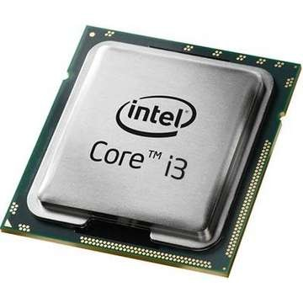
INTEL CORE I3
Introduced in 2010.
It is a 64-bit µP.
31

Slide 34
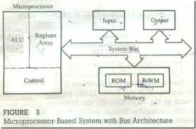
Formal structure of Microprocessors:

Slide 35
Bit: A bit is a single binary digit.
Word: A word refers to the basic data size or bit size that can be processed by the arithmetic and logic unit of the processor. A 16-bit binary number is called a word in a 16-bit processor.
Bus: A bus is a group of wires/lines that carry similar information.
System Bus: The system bus is a group of wires/lines used for communication between the microprocessor and peripherals.
Memory Word: The number of bits that can be stored in a register or memory element is called a memory word.
Address Bus: It carries the address, which is a unique binary pattern used to identify a memory location or an I/O port. For example, an eight bit address bus has eight lines and thus it can address 28 = 256 different locations. The locations in hexadecimal format can be written as 00H – FFH.
Data Bus: The data bus is used to transfer data between memory and processor or between I/O device and processor. For example, an 8-bit processor will generally have an 8-bit data bus and a 16-bit processor will have 16-bit data bus.
Control Bus: The control bus carry control signals, which consists of signals for selection of memory or I/O device from the given address, direction of data transfer and synchronization of data transfer in case of slow devices.

Slide 36
Language of Microprocessors:
Each microprocessor has a set of instructions, a list which is provided by the microprocessor manufacturer. The instruction set of a microprocessor is provided in two forms: binary machine code and mnemonics.
Microprocessor communicates and operates in binary numbers 0 and 1. The set of instructions in the form of binary patterns is called a machine language
and it is difficult for us to understand. Therefore, the binary patterns are given abbreviated names, called mnemonics, which forms the assembly language.
The conversion of assembly-level language into binary machine-level language is done by using an application called assembler.

Slide 37
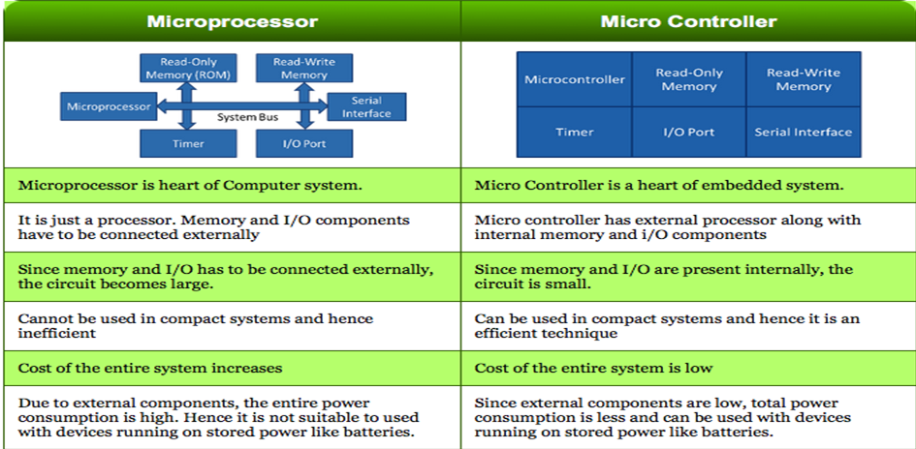
Microprocessors Vs Microcontroller:

Slide 38
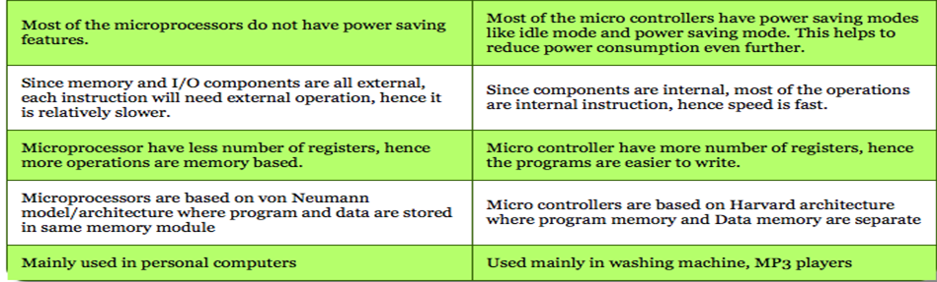
Microprocessors Vs Microcontroller:

Slide 39
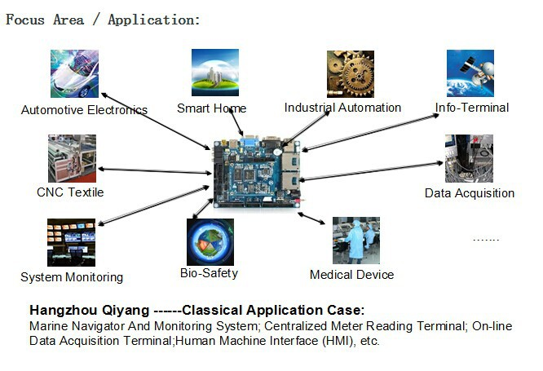
Application - <<Microprocessor>>

Slide 40
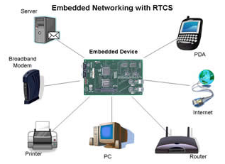
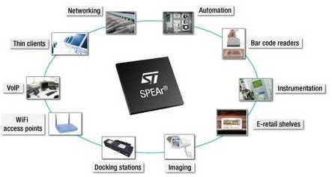

Slide 41
THANK YOU

